Slide 1
Information Technology Investment: Decision Making Methodology
2nd Edition
Chapter 5
Other Financial Methods

Slide 2
Chapter Outline:
Introduction
What Types of Methodologies Support IT Investment Decision-Making?
What is Present Value Analysis Methodology?
What is Return on Investment Methodology?
What is Internal Rate of Return?
Chapter 5 Discussion Questions

Slide 3
I. Introduction
The time-value of money invested in IT must be considered in most investment decision making situations, since alternative investment exist that may be more profitable
This chapter looks at a variety of financial IT investment decision-making methodologies
This chapter is just a summary chapter that spends most of its time listing methodologies that will in some cases be more fully discussed in other chapters

Slide 4
II. What Types of Methodologies Support IT Investment Decision-Making?
Various financial methodologies can be divided into four categories:
(1) Financial Techniques: Not used for optimization and can be used to consider both tangible and intangible criterion, examples include….

Slide 5
II. What Types of Methodologies Support IT Investment Decision-Making?
 | Description | Type of criteria | Evaluation timing
Accounting Rate of Return | Compare the average after-tax profits with initial investment cost | Tangible | Ex ante or ex post
Breakeven Analysis | Compare the present value of costs with the present value of benefits | Tangible and intangible | Ex ante, most often
Cost Benefit Analysis | Compare costs with benefits that can be directly and indirectly attributed to the system | Tangible and intangible | Ex ante or ex post
Cost Benefit Ratio | Calculate the ratio of costs of an IT investment to its benefits measured in monetary terms and compare to a threshold ratio | Tangible | Ex ante and ex post
Cost Revenue Analysis | Compare costs with benefits that can be directly attributed to the system | Tangible | Ex ante, most often

Slide 6
II. What Types of Methodologies Support IT Investment Decision-Making? (Continued)
 | Description | Type of criteria | Evaluation timing
Internal Rate of Return | Calculate the return that equates the net present value of an investment to zero | Tangible | Ex ante or ex post
Net Present Value Analysis | Discount cash inflows and compare them to cash outflows | Tangible | Ex ante or ex post
Payback Period | Calculate the time required to recoup initial cost | Tangible | Ex ante, most often
Profitability Index | Calculate the per dollar contribution of an investment | Tangible | Ex ante or ex post
Return on Investment | Calculate the return of an investment | Tangible | Ex ante or ex post

Slide 7
II. What Types of Methodologies Support IT Investment Decision-Making?
Various financial methodologies can be divided into four categories:
(2) Operations Research/Management Science Techniques: Most are optimization methods, focused less on financial data but can be used to consider both tangible and intangible criterion, examples include….

Slide 8
II. What Types of Methodologies Support IT Investment Decision-Making?
 | Description | Type of criteria | Evaluation timing
Analytical Hierarchy Process | Calculate the score of decision-makers’ pair wise comparisons | Tangible and intangible | Ex ante
Decision/ Bayesian Analysis | Calculate the expected value of investing in alternative investments | Tangible and intangible | Ex ante
Delphi Evidence | Obtain consensus of experts’ opinion concerning the best alternative investment | Tangible and intangible | Ex ante and ex post

Slide 9
II. What Types of Methodologies Support IT Investment Decision-Making? (Continued)
 | Description | Type of criteria | Evaluation timing
Game Playing | Calculate payoff of investment based on actions of the competition, mathematics, and economic theory | Tangible and intangible | Ex ante
Multi-objective, Multi-Criteria Approaches | In general, develop a measure of utility provided by an IT investment | Tangible and intangible | Ex ante and ex post
Simulation | Model how an investment will perform and impact the organization | Tangible and intangible | Ex ante and ex post

Slide 10
II. What Types of Methodologies Support IT Investment Decision-Making?
Various financial methodologies can be divided into four categories:
(3) Techniques Specifically Designed for IT Investment Decision-Making: The previous methods are very general for any type of decision-making but here we are focusing on IT investment decision-making, examples include….

Slide 11
II. What Types of Methodologies Support IT Investment Decision-Making?
 | Description | Type of criteria | Evaluation timing
Application Benchmark Technique | Construct a computer program to be run by vendors so as to determine the run time of individual computer system configurations | Tangible | Ex ante
Application Transfer Team | Conduct a study to determine exact requirements of the IT and to support the business case | Tangible and intangible | Ex ante
Automatic Value Points | Calculate the degree of automation based on a set of criteria concerning the contribution of IT to the overall business performance | Tangible and intangible | Ex ante and ex post
Bedell’s Method | Calculate contribution of an IT system by multiplying an importance score by the level of quality improvement made by the system | Tangible and intangible | Ex post and ex ante

Slide 12
II. What Types of Methodologies Support IT Investment Decision-Making? (Continued)
 | Description | Type of criteria | Evaluation timing
Benefit/ Risk Analysis | Determine the overall risk of an investment through the use of a risk questionnaire and judge whether the benefits outweigh the risks | Intangible | Ex ante
Buss’s Method | Determine investment priority by ranking alternative investments and those with the highest frequency have highest priority | Tangible and intangible | Ex ante
Cost-value Technique | Total all costs associated with a system and deduct an earned value (established dollar value of desirable feature minus vendor charge for desirable feature) | Tangible | Ex ante
Executive Planning for Data\ Processing | Conduct a comparison of costs and benefits of existing systems and examine areas for future investment | Tangible and intangible | Ex ante

Slide 13
II. What Types of Methodologies Support IT Investment Decision-Making? (Continued)
 | Description | Type of criteria | Evaluation timing
Information Economics | Calculate the overall value of an investment based on enhanced ROI, business domain, and technology domain criteria | Tangible and intangible | Ex ante
Information Systems Investment Strategies | Make a financial comparison between the organization and its competitors, examine the portfolio of existing applications and prepare the business case for areas with expected high returns | Tangible and intangible | Ex ante
Investment Mapping | Calculate evaluation criteria scores and plot investment alternatives on a grid | Tangible and intangible | Ex ante and ex post
Investment Portfolio | Calculate contribution of IT system to business and technology domain and calculate financial consequences (NPV) of the system | Tangible and intangible | Ex ante

Slide 14
II. What Types of Methodologies Support IT Investment Decision-Making? (Continued)
 | Description | Type of criteria | Evaluation timing
Investment Portfolio | Calculate contribution of IT system to business and technology domain and calculate financial consequences (NPV) of the system | Tangible and intangible | Ex ante
Knowledge Based System for IS Evaluation | Obtain an overall quantitative rank based on traditional capital budgeting techniques and an overall qualitative rank of projects based on rules established by MIS planning groups and MCDM models | Tangible and intangible | Ex ante
MIS Utilization Technique | Calculate the overall success of an IT investment based on 48 performance criteria | Tangible and intangible | Ex post
Process Quality Management | Analyze mission, critical success factors and key business processes to identify areas for IT investment | Tangible and intangible | Ex post

Slide 15
II. What Types of Methodologies Support IT Investment Decision-Making? (Continued)
 | Description | Type of criteria | Evaluation timing
Requirements-Costing Technique | Calculate total cost of an investment as cost of the mandatory features plus additional costs for desirable but not included features | Tangible | Ex ante (mostly for vendor selection decisions)
Return on Management | Calculate the return of an investment that can be attributed to management productivity | Tangible | Ex post, most often
SESAME | Compare the cost of a computer system with the cost of performance without a computer system | Tangible | Ex ante and ex post
SIESTA | Assess benefits and risks of the fit between IT technology strategy/infrastructure and business strategy/infrastructure | Mostly intangible | Ex ante and ex post

Slide 16
II. What Types of Methodologies Support IT Investment Decision-Making?
 | Description | Type of criteria | Evaluation timing
Strategic Application Search and Systems Invest. Meth. | Analyze the extent of existing systems and identify the most productive areas for future investment | Intangible | Ex ante, most often
Value Analysis | Establish value of a system (and/or prototype) by asking management simple value-related questions and compare that value to investment cost | Tangible and intangible | Ex ante
Ward’s Portfolio Approach | Assess risk of investment and risk of the portfolio of investments after undertaking investment | Tangible and intangible | Ex ante and ex post
Zero-based budgeting | Partition projects into smaller projects, assess each smaller project based on the same evaluation framework, and select the most important smaller projects assuming limited funding | Tangible and intangible | Ex ante

Slide 17
II. What Types of Methodologies Support IT Investment Decision-Making?
Various financial methodologies can be divided into four categories:
(4) Other Techniques for IT Investment Decision-Making: This is an odd-mixed group of left-over IT investment decision-making methods that are in some cases very new to this type of decision-making, examples include….

Slide 18
II. What Types of Methodologies Support IT Investment Decision-Making? (Continued)
 | Description | Type of criteria | Evaluation timing
Balanced Scorecard | Evaluate an investment from the user’s, business value, efficiency, and innovation/ learning perspectives | Tangible and intangible | Ex ante and ex post
Boundary Values/Spending Ratios | Calculate the ratio of IT cost to a known aggregate value (total sales, total assets, etc.) | Tangible | Ex post, most often
Cost Displacement/ Avoidance | Compare the cost of IT investment to the current costs displaced by the IT system plus the projected costs avoided by the system | Tangible | Ex ante
Cost Effectiveness Analysis | Compare the effectiveness of a system with its cost and select the system with the lowest cost, best effectiveness, or the optimal combination of both | Tangible and intangible | Ex ante and ex post

Slide 19
II. What Types of Methodologies Support IT Investment Decision-Making? (Continued)
 | Description | Type of criteria | Evaluation timing
Critical Success Factors | Obtain, compare, and rank factors critical to business success, and based on these rankings, deduce investment priorities | Intangible | Ex ante
Hedonic Wage | Based on employee activity time allocation, calculate the marginal value of each employee and use these values to estimate the value of IT investment benefits | Tangible | Ex ante and ex post
Real Options Valuation | Calculate additional value of investment that exists because it provides the option for a second investment | Tangible and intangible | Ex ante
Quality Engineering | Translate perceived value and risk into a quality score | Intangible | Ex ante and ex post

Slide 20
II. What Types of Methodologies Support IT Investment Decision-Making? (Continued)
 | Description | Type of criteria | Evaluation timing
Satisfaction/ Priority Surveys | Survey and compare user and IS professionals’ opinions on the effectiveness and importance of installed systems | Intangible | Ex ante and ex post
Structural Models | Create a model to analyze how an information system affects the costs and revenues of the particular business function or line of business it is intended to serve | Tangible and intangible | Ex ante and ex post
Time Savings Times Salary | Calculate the value added of an IT investment by estimating the percentage of time the system will save workers and multiply by the cost of the workers | Tangible | Ex ante
Value Chain Analysis | Assess how an IT investment can provide competitive advantage in each phase of the chain | Tangible and intangible | Ex ante and ex post

Slide 21
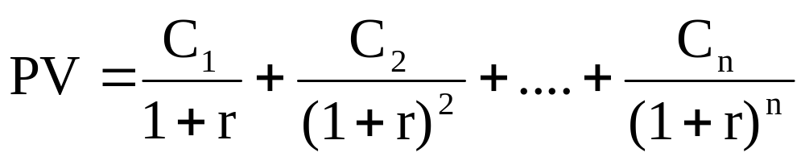
III. What is Present Value Analysis Methodology?
Present value (PV) is the value of future cash flows from an investment today. Formula…
Where C₁…C_{n} are the expected cash flows for n time periods, and r is the “discount rate.” The discount rate, also called the opportunity cost of capital, is the rate that could be earned by investing in securities of comparable risk to that of the investment.

Slide 22
III. What is Present Value Analysis Methodology?
Net Present value (NPV) decision rule:
For an independent investment, the following rules may be used to guide the investment decision:
If NPV is greater than zero, then make the investment.
OR
If NPV is less than or equal to zero, then do not make the investment.

Slide 23
III. What is Present Value Analysis Methodology?
Net Present value (NPV) example from the textbook (Data):
 | Alternative A Payroll System | Alternative B Payroll System | Alternative C Payroll System
Initial Cost | $100,000 | $100,000 | $100,000
Cash Flow Year 1 | $40,000 | $25,000 | $65,000
Cash Flow Year 2 | $40,000 | $30,000 | $65,000
Cash Flow Year 3 | $40,000 | $45,000 | $20,000
Cash Flow Year 4 | $40,000 | $55,000 | $20,000

Slide 24
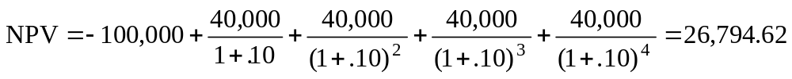
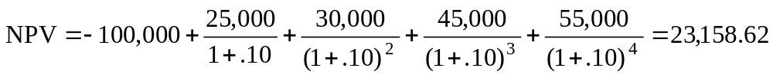
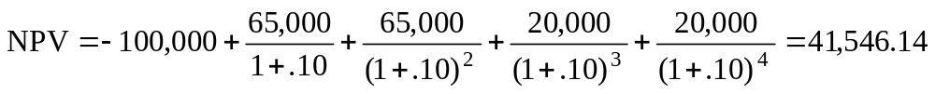
III. What is Present Value Analysis Methodology?
Net Present value (NPV) example from the textbook (Solution):
Alternatives | NPV Calculation
Alternative A Payroll System
Alternative B Payroll System
Alternative C Payroll System
Largest NPV is the best: Select Aternative C

Slide 25
IV. What is Return on Investment Methodology?
Return on investment (ROI) is used when the rate of return of an investment is compared with the opportunity cost of capital
The opportunity cost of capital may be thought of as the expected return forgone by investing in technology rather than in an equally risky investment in the capital market
The ROI is calculated as the profit of the investment divided by the cost of the investment. If the return from the investment is greater than the opportunity cost of capital then the investment is worth more than it costs and should be undertaken.

Slide 26
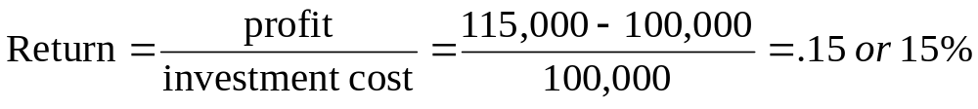
IV. What is Return on Investment Methodology?
Return on investment (ROI) example from the textbook:
Let’s evaluate a technology investment that costs $100,000 and will return $115,000 at the end of one year. Let’s assume that this investment has similar risk to that of a security in the capital market with a return of 12 percent. ROI or Return is calculated as follows:
The return on the investment is 15 percent, which is greater than the opportunity cost of capital of 12 percent and thus the investment in the computer technology should be undertaken

Slide 27
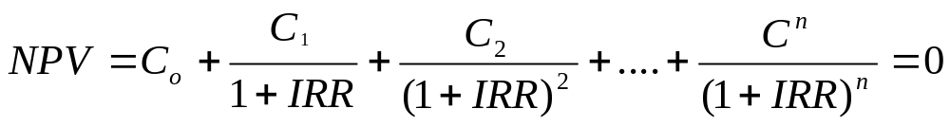
V. What is Internal Rate of Return?
Internal rate of return (IRR), also called discounted-cash-flow rate of return, is the discount rate that makes the NPV of a project equal zero
IRR is an extension or special case of the net present value methodology where the IRR is the rate that equates the present value of the cash flows with the initial investment

Slide 28
V. What is Internal Rate of Return?
For an independent investment, the following rules may be used to guide the investment decision using the IRR:
If IRR is greater than the opportunity cost of capital, then make the investment.
OR
If IRR is less than or equal to the opportunity cost of capital, then do not make the investment.

Slide 29
VI. Chapter 5 Discussion Questions
1. Why do you think there are so many IT investment methodologies?
2. Why were the methodologies categorized into the four different categories in this chapter?
3. Why do you think PVA is so often used with other IT investment decision making methodologies?
4. What does the “opportunity cost of capital” really mean?
5. How can an “unequal investment life” impact an IT investment decision?
6. How can an “unequal investment size” impact an IT investment decision?
END OF CHAPTER 5

